Slide 1

Green University Of Bangladesh
Department Of Computer Science and Engineering(CSE) Faculty Of Science and Engineering
Course Title: Data Structure Course Code: CSE-105 Section: PC-221DG
Presentation Topic: Minimum Spanning Tree
Course Instructor: | Team Details:
JARIN TASNIM TONVI Lecturer | Heaven Bawm 221902015 Md. Sahid 221902057 Md. Mahim Hossain 221902082

Slide 2
Glimpse of the Topics
Introduction
Properties
Algorithms
Applications

Slide 3

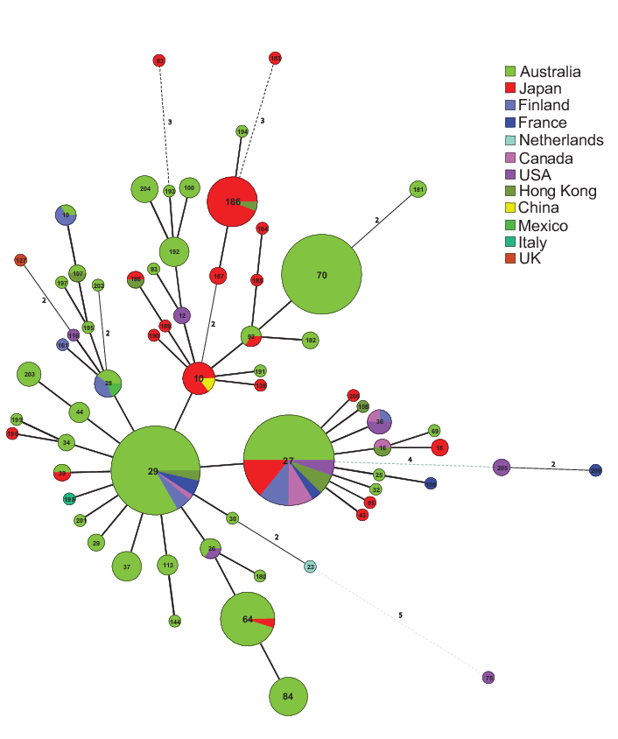
Minimum Spanning Tree
Minimum Spanning Tree

Slide 4
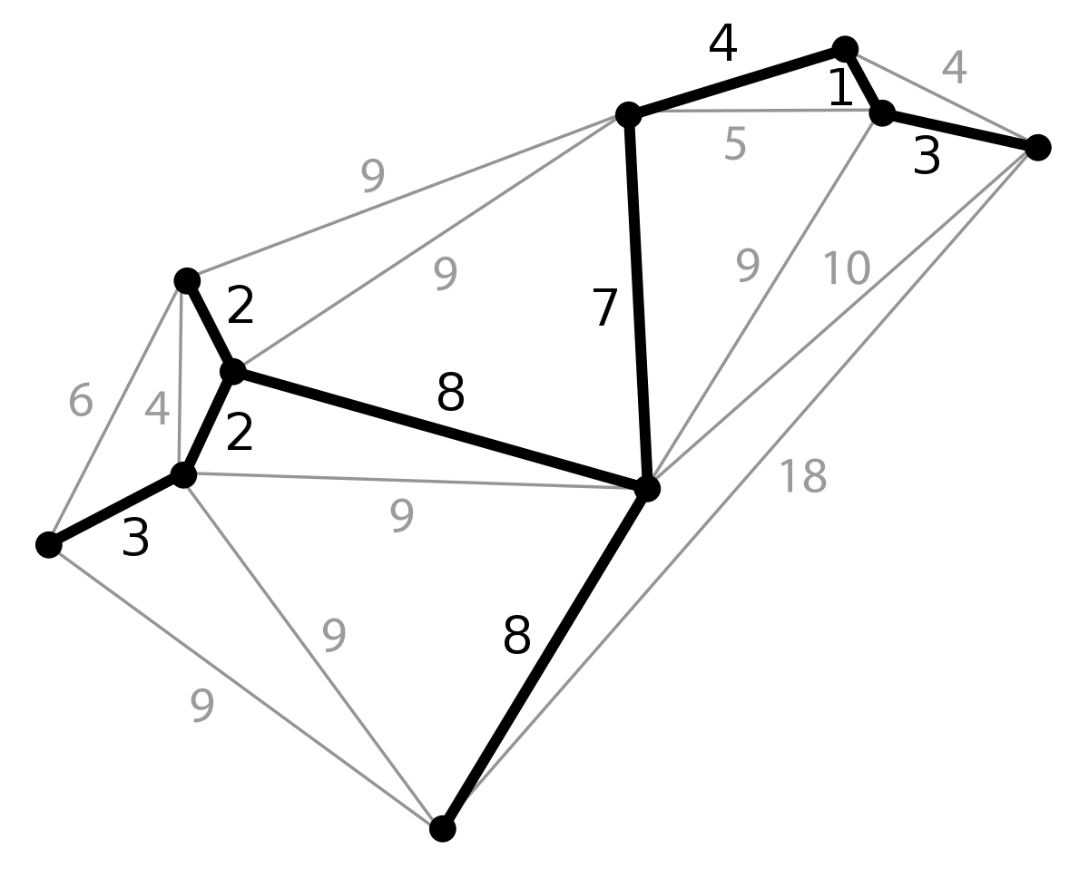
Introduction
A minimum spanning tree is a special kind of tree that minimizes the lengths (or “weights”) of the edges of the tree.

Slide 5
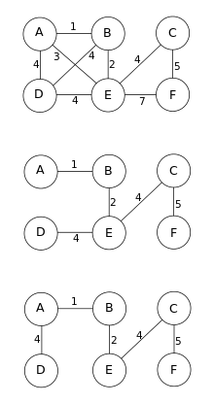
Properties
Possible Multiplicity
Uniqueness
Minimum Cost Subgraph
Cycle Property
Minimum Cost Edge

Slide 6
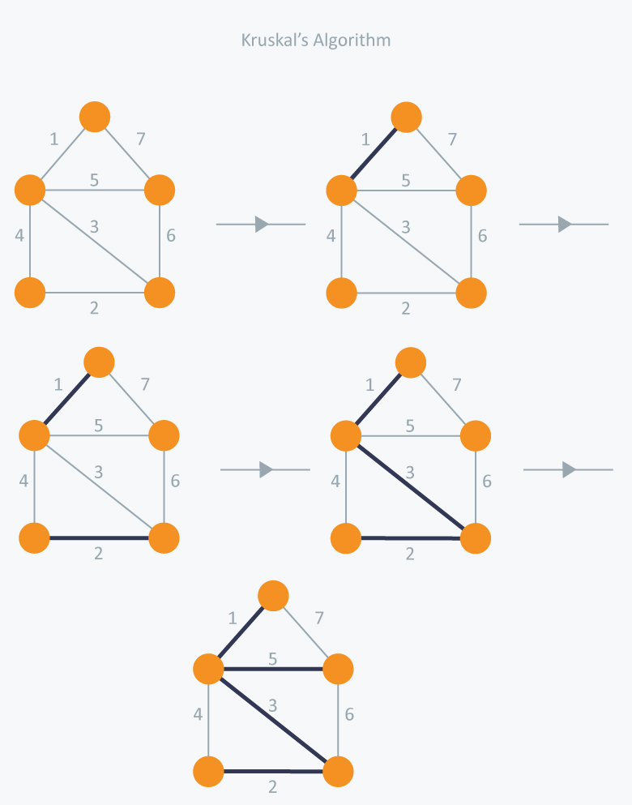
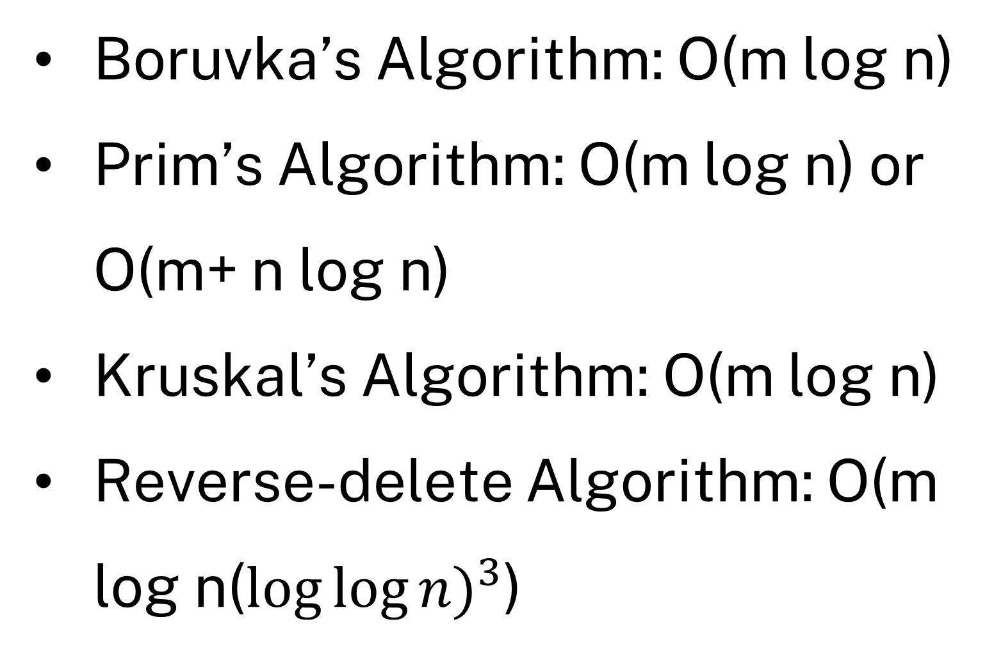
Algorithms
Boruvka’s Algorithm: O(m log n)
Prim’s Algorithm: O(m log n) or O(m+ n log n)
Kruskal’s Algorithm: O(m log n)
Reverse-delete Algorithm: O(m log n(${\log{\log{n)}}}^{3}$)

Slide 7
Applications
Cluster Analysis.
Real-time face tracking and verification (i.e. locating human faces in a video stream).
Protocols in computer science to avoid network cycles.
Entropy based image registration.
Max bottleneck paths.

Slide 8
Thank You

